Slide 1





Day 7 Transactions & Advanced SQL
Sean Wong
2025/08/04

Slide 2

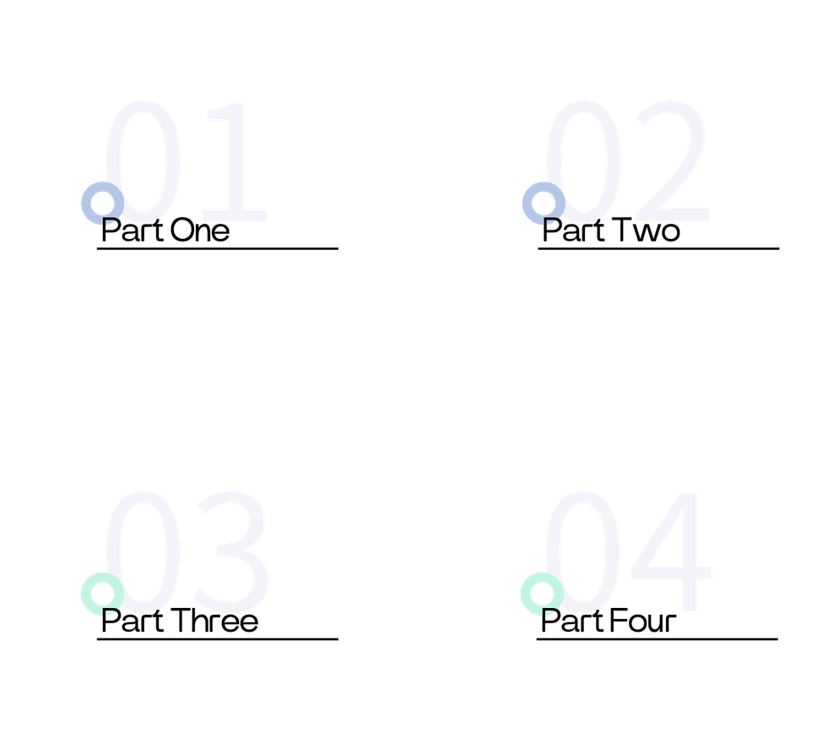
CONTENTS
Transaction Essentials
Isolation & Locking
Advanced SQL Objects
Practice & Recap

Slide 3

Transaction Essentials

Slide 4



Transaction Definition
A database transaction is a sequence of one or more SQL operations executed as a single unit. It ensures that either all changes are committed or none are, maintaining data integrity.
Real-life Analogy
Think of a bank transaction where you transfer money from one account to another. If any step fails, the entire transaction is rolled back to maintain accurate account balances.
What Is a Database Transaction

Slide 5


ACID Properties Explained
Isolation
Atomicity
Isolation ensures that transactions are executed independently of each other, preventing interference and ensuring data accuracy even with concurrent operations.
Atomicity ensures that transactions are all or nothing. If one operation fails, the entire transaction is rolled back, preventing partial updates.
Consistency
Durability
Consistency guarantees that a transaction takes the database from one valid state to another, ensuring data integrity and correctness.
Durability ensures that once a transaction is committed, its changes are permanent, even in the event of a system crash or failure.

Slide 6



START TRANSACTION
COMMIT
ROLLBACK
The START TRANSACTION command begins a new transaction, allowing you to group multiple SQL operations together.
The COMMIT command saves all changes made during the transaction, making them permanent in the database.
The ROLLBACK command reverts all changes made during the transaction, ensuring data consistency if an error occurs.
MySQL Transaction Commands

Slide 7

Code Walkthrough Transaction
Transaction Example
Example: Adding an employee and recording their salary payment within a transaction. If both operations succeed, the changes are committed. If any fail, the transaction is rolled back.

Slide 8
Isolation & Locking

Slide 9


Isolation Levels Compared
READ UNCOMMITTED
READ COMMITTED
REPEATABLE READ
Allows dirty reads, where transactions can see uncommitted changes from other transactions. This level offers the least isolation.
Prevents dirty reads but allows non-repeatable reads. This level ensures that only committed changes are visible.
Ensures that the data read during the transaction will not change, providing a consistent view of the data.

Slide 10

Lock Types and Deadlocks
Shared Locks
Exclusive Locks
Shared locks allow multiple transactions to read the same data but prevent any transaction from modifying it until the lock is released.
Exclusive locks allow only one transaction to modify the data, blocking all other transactions from accessing it until the lock is released.

Slide 11
Advanced SQL Objects

Slide 12


Stored Procedures Benefits
Definition
Security
Stored procedures are predefined SQL queries that can be executed multiple times with different parameters, encapsulating complex logic.
They enhance security by limiting direct access to the database, exposing only the procedure interface to end-users.
Reusability
Performance
Stored procedures promote reusability by allowing you to execute the same logic repeatedly with different inputs, reducing redundancy.
Stored procedures can improve performance by reducing network traffic and optimizing execution plans.

Slide 13


Types
Triggers Automate Logic
Triggers can be set to execute BEFORE or AFTER an event, allowing you to enforce business rules or maintain data integrity.
Definition
Triggers are automatic actions that occur when specific database events like INSERT, UPDATE, or DELETE happen on a table.
Example
Example: A trigger can automatically update a timestamp column whenever a row is modified, ensuring accurate tracking of changes.

Slide 14

Views Simplify Access
Definition
Views are virtual tables based on the result of a SELECT query, providing a simplified interface to complex data.
Benefits
Views abstract away database structure, making it easier to query complex joins and filters without exposing underlying tables.

Slide 15
Practice & Recap

Slide 16

Lab 1 Transactions in Action
Lab Objective
Practice transaction commands by beginning a transaction, performing multiple operations, and using ROLLBACK in case of errors to ensure data consistency.

Slide 17


Trigger
Set up a trigger to automatically update a timestamp column on row modification, ensuring data consistency and accuracy.
View
Stored Procedure
Create a view to simplify querying employee details, abstracting away complex joins and making data access more intuitive.
Create a stored procedure to insert a new employee, demonstrating how to encapsulate logic and improve reusability.
Lab 2 Advanced Objects

Slide 18

Key Takeaways Roadmap
ACID Properties
ACID properties (Atomicity, Consistency, Isolation, Durability) form the foundation of reliable database systems.
Transactions
Transactions ensure data consistency and integrity through commands like START TRANSACTION, COMMIT, and ROLLBACK.
Advanced SQL Features
Stored procedures, triggers, and views automate database operations and improve performance by encapsulating logic and simplifying access.
Next Steps
Continue practicing these concepts through labs, projects, and real-world applications to deepen your understanding.

Slide 19

Q&A and Closing
Open Floor for Questions
Open the floor for any questions or clarifications. Encourage participants to share their thoughts and experiences.
Next Course Suggestions
Suggest continuing the learning journey with advanced topics such as Performance Tuning or Database Design.

Slide 20



Sean Wong
2025/08/04

